Slide 1
Chapter 9 - Multimodal Large Language Models
From the book Hands-On Large Language Models

Slide 2
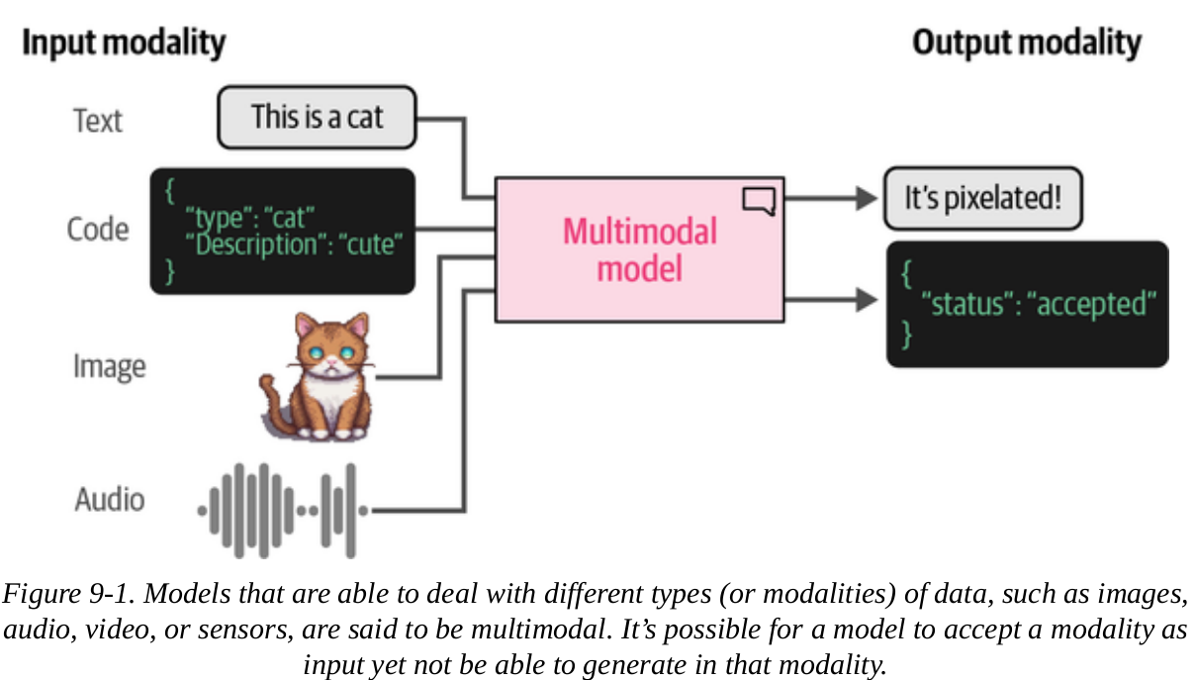
Multimodality in LLMs
Multimodality in large language models (LLMs) refers to the ability of these models to process and understand multiple types of data, such as text, images, and audio.
A model that is able to handle text and images (each of which is called a modality) is said to be multimodal

Slide 3
Multimodality in LLMs
Just like in real life, communication includes body language and facial expressions, not just words.
If an LLM can process images, audio, and text, it would be better at giving an output for a query.
Imagine you not only read, but witness a story, you would be able to make a better response to a question about it.

Slide 4
Transformers for Vision
Because of the increasing usefulness of transformers, scientists have looked into its potential in the field of computer vision.
They came up with a method called the Vision Transformer (ViT).
Vision Transformer (ViT)
is a type of neural network architecture that applies the transformer model.
it processes images by dividing them into patches, treating these patches as sequences, and using self-attention to capture relationships across the entire image.

Slide 5
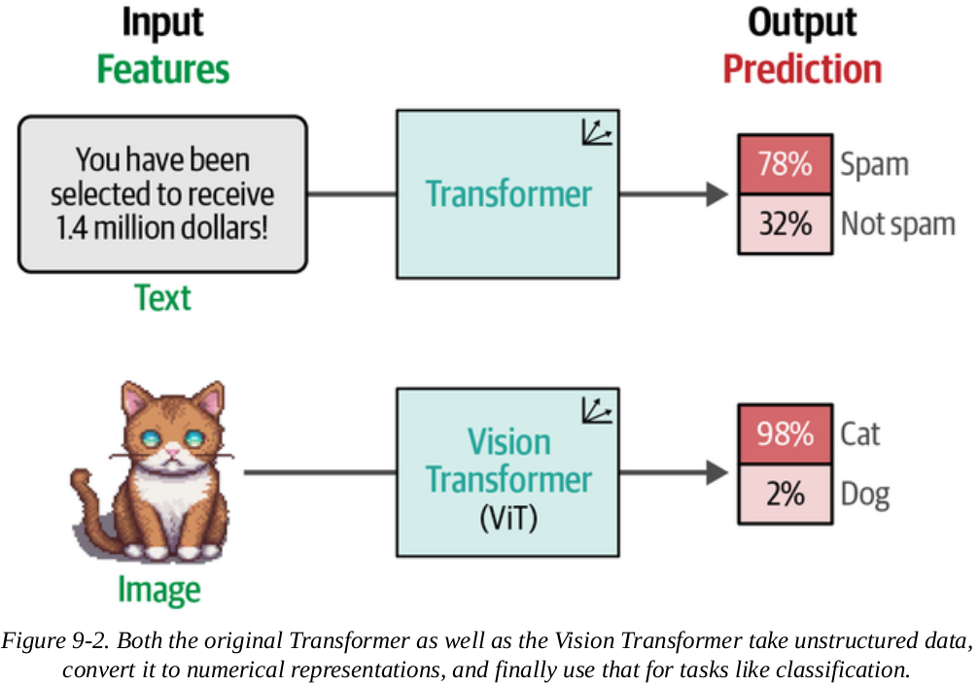
Transformers for Vision
Like the original Transformer, ViT is used to transform unstructured data into representations (embeddings).

Slide 6
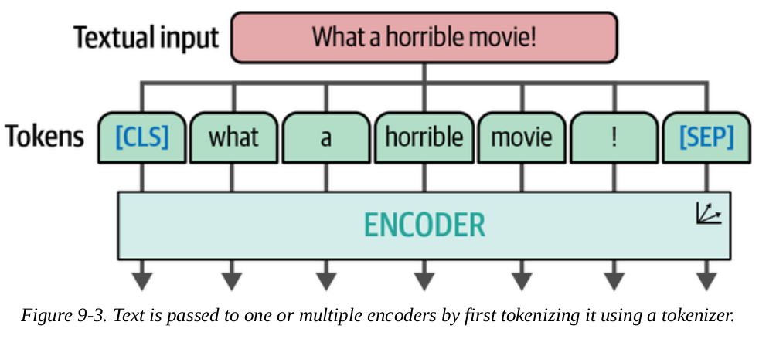
Transformers for Vision
ViT relies on the encoder component of the Transformer architecture.
The encoder converts textual input into embeddings before being passed to the decoder.

Slide 7
Transformers for Vision
Unlike text, an image does not consist of words, so the tokenization process is different for images.
The authors of ViT came up with a method for tokenizing images into "words."
This lets them use the original encoder structure.

Slide 8
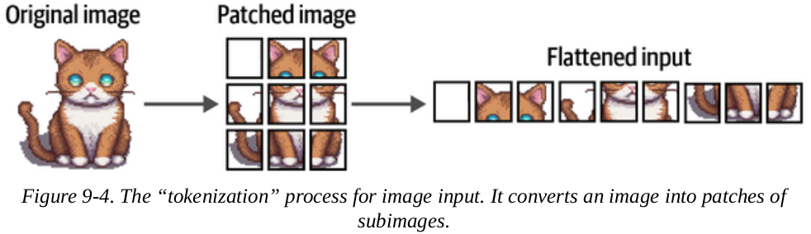
Transformers for Vision
Unlike tokens which use a vocabulary to find their individual separate meaning, an individual pixel doesn't tell you much.
The creators of ViT knew this and took this into account. So instead of processing separate pixels, ViT uses patches of an image.

Slide 9
Transformers for Vision
In the original ViT paper, a patch is of size 16 x 16 x 3 (RGB channels).
Then, the RGB values for each patch are normalized to a 0-1 range.
Each patch (16 x 16 x 3) is flattened into a single vector of 768 values.
Each flattened patch vector is then passed through a linear projection layer (a simple neural network) to generate an embedding for that specific patch.
The vector for each patch now works like tokens

Slide 10
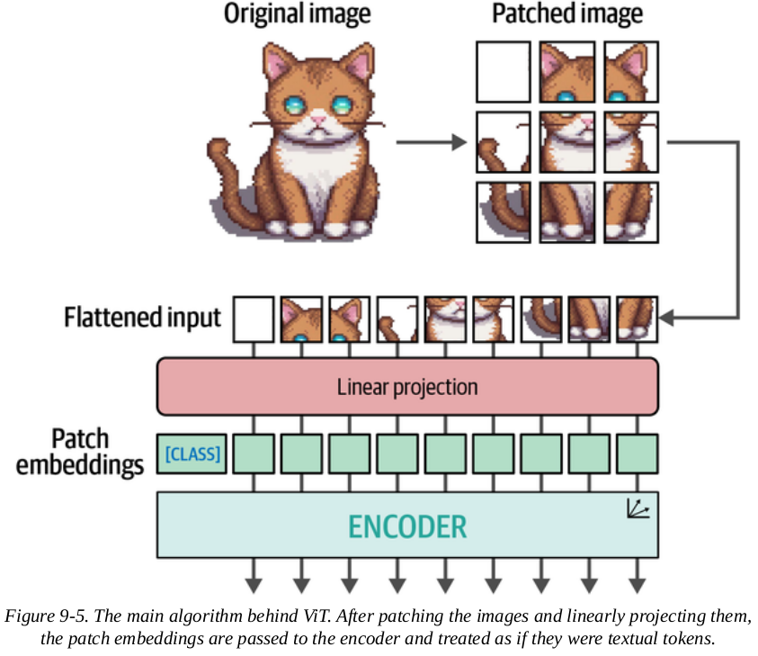
Transformers for Vision
These embeddings can then be used as input to a Transformer model.
The rest of the process is identical to that for textual data.
The process is illustrated here

Slide 11
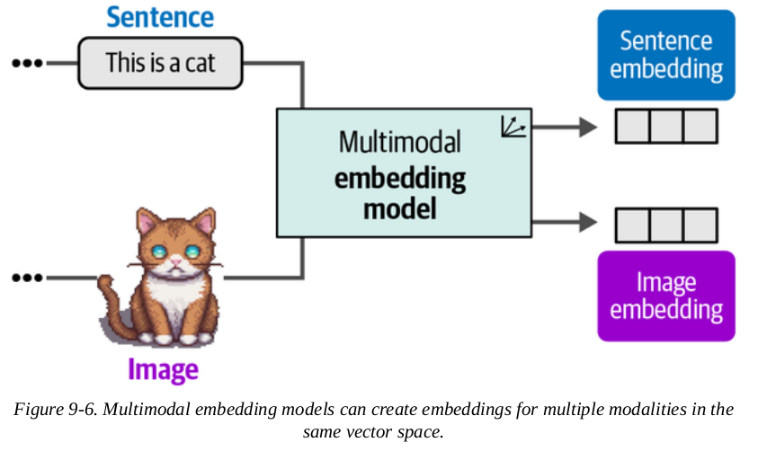
Multimodal Embedding Models
Multimodal embedding models are models that can take in generated embeddings for images and be able to compare them against text embeddings in the same embedding space.

Slide 12
Multimodal Embedding Models
One major advantage of using a multimodal embedding model is its ability to compare/process representations (vectors) of both images and texts.
This ability can be helpful for search engines, databases, and other use cases.
Having embeddings of both images and texts in the same embedding space means a search for 'puppies' using a text query and an image query will work.

Slide 13
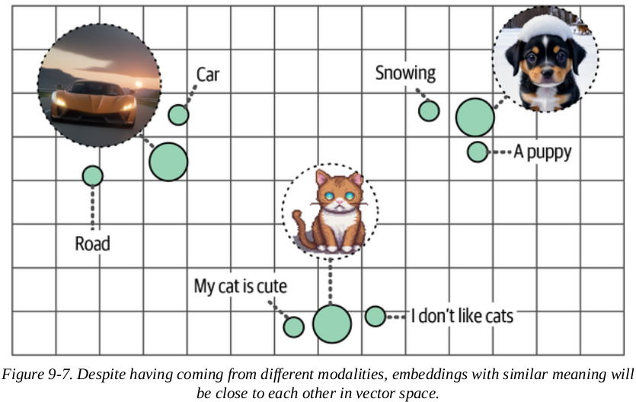
Multimodal Embedding Models
For example:
"What is a puppy?" or "Which documents are most related to a given image?"

Slide 14
CLIP: Connecting Text and Images
CLIP (Contrastive Language-Image Pre-training) is an embedding model that can compute embeddings of both images and text.
the embeddings from CLIP lie in the same vector space.
this means you can compare image embeddings with text embeddings.

Slide 15
CLIP: Connecting Text and Images
CLIP can be used for tasks such as:
Zero-shot Classification
Classify content into predefined categories by comparing embeddings, without needing training examples for each class.
Clustering
Cluster images and keywords together to see which keywords belong to which sets of images, for example.
Search
Find relevant text or images based on an input text or image.
Generation
guides the generative model to adjust each step according to the similarity comparison (of text and image embeddings), increasingly matching the text description embedding.

Slide 16
How Can CLIP Generate Multimodal Embeddings?
The dataset used to train CLIP contains millions of such pairs, each consisting of one image and its corresponding text caption.
CLIP uses an image encoder (e.g., ViT) and a text encoder
Cosine similarity is calculated by taking the dot product of the embeddings and dividing by the product of their norms (lengths).

Slide 17
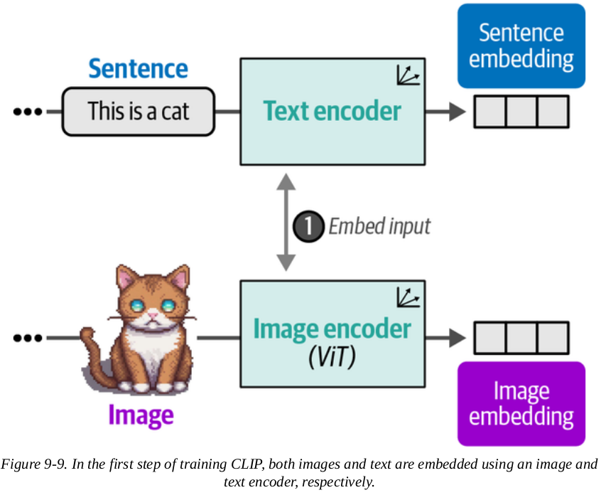
How Can CLIP Generate Multimodal Embeddings?
The first step is illustrated below

Slide 18
How Can CLIP Generate Multimodal Embeddings?
The training starts with low/random similarity scores between image and text embedding pairs
These embeddings are initially in different embedding spaces, although of the same dimensions.
As the process continues, the loss function updates both the image and text encoders' weights through backpropagation.
This method is called contrastive learning.

Slide 19
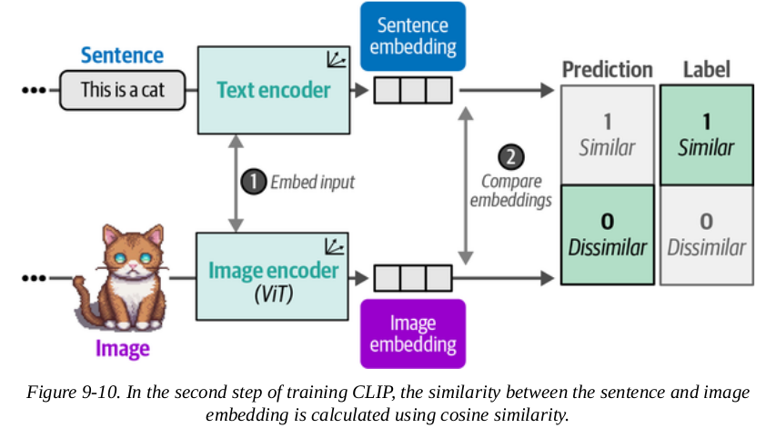
How Can CLIP Generate Multimodal Embeddings?
As training progresses, the similarity between matching pairs is maximized while the similarity between non-matching pairs is minimized.

Slide 20
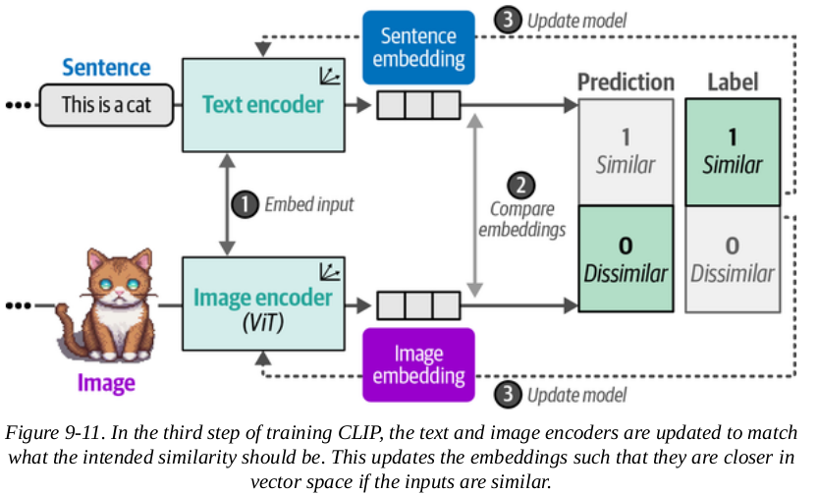
How Can CLIP Generate Multimodal Embeddings?
Eventually, the embedding of an image of a cat should be similar to the embedding of the text "a picture of a cat."

Slide 21
OpenCLIP
OpenCLIP is the open-source variant of CLIP
Using OpenCLIP (or any CLIP model) comes down to two things:
Processing the textual and image inputs
Then passing them to the main model

Slide 22
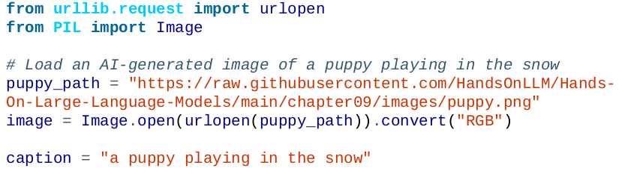
OpenCLIP
Let's look at an example. We'll use an AI-generated image of a puppy playing in the snow:
Since we have a caption for this image, we can use OpenCLIP to generate embeddings for both text and image.

Slide 23
OpenCLIP
To generate these embeddings, we load three models:
A tokenizer for tokenizing the textual input
A preprocessor to preprocess and resize the image
The main model that converts the previous outputs to embeddings

Slide 24
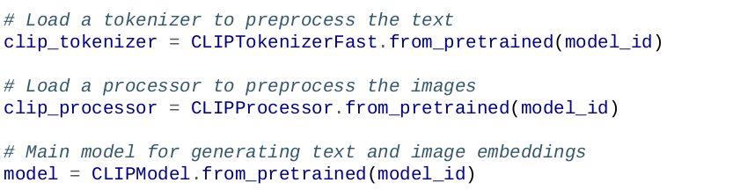
OpenCLIP

Slide 25
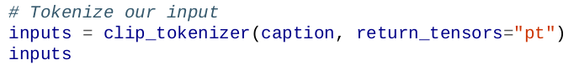
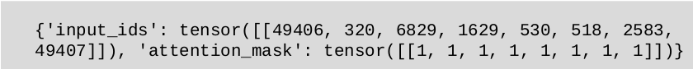
OpenCLIP
We'll see what happens when we preprocess our input:
This outputs a dictionary that contains the IDs of the input:

Slide 26
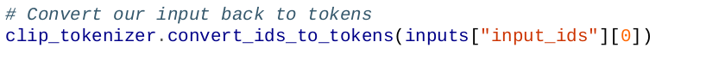
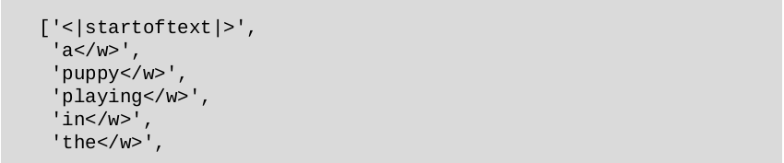
OpenCLIP
To see what those IDs represent, we can convert them to tokens using the named convert_ids_to_tokens function:
This gives us the following output:

Slide 27
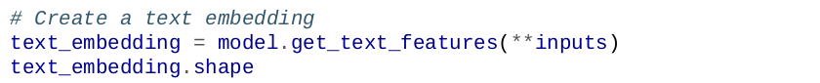
OpenCLIP
Now that we have preprocessed our caption, we can create the embedding:
This results in an embedding that has 512 values for this single string:

Slide 28
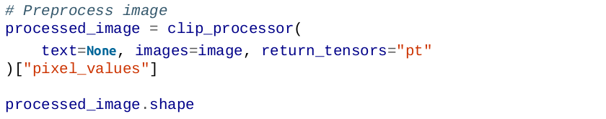
OpenCLIP
Just like with text, the model expects the input image to have certain characteristics including size and shape, using the processor we created before:
The original image was 512 × 512 pixels. The preprocessing reduced it to 224 × 224 pixels.

Slide 29
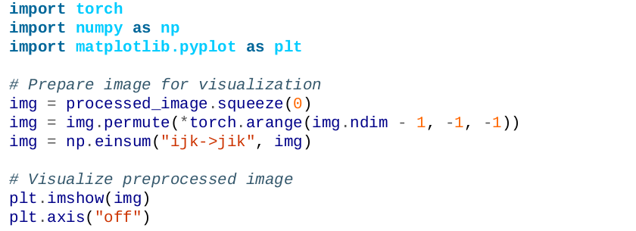
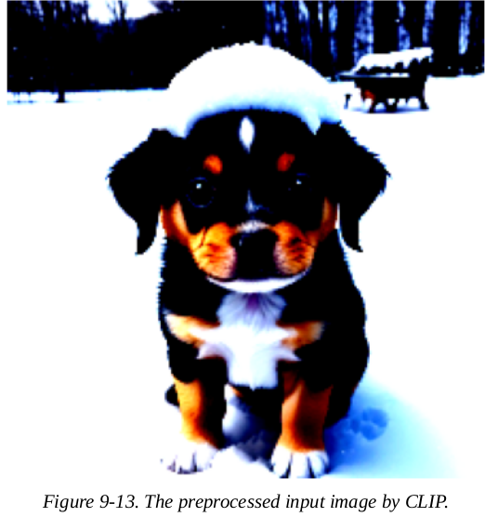
OpenCLIP
Let’s visualize the results of this preprocessing:

Slide 30
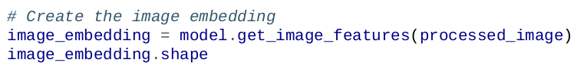
OpenCLIP
To convert this preprocessed image into embeddings, we can call the model as we did before and explore what shape it returns:
This gives us the following shape:
The resulting image embedding is the same as that of the text embedding. We can use these embeddings to calculate how similar they are.

Slide 31
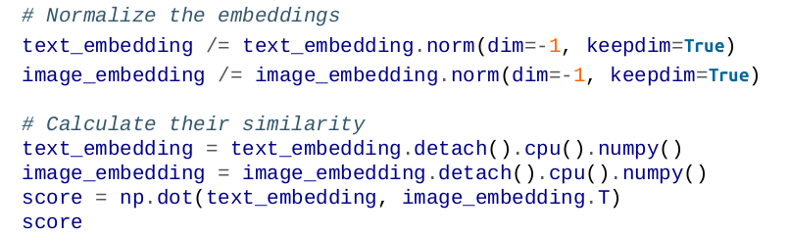
OpenCLIP
To be able to compare their similarity score, we first normalize the embeddings:
This gives us the following score:

Slide 32
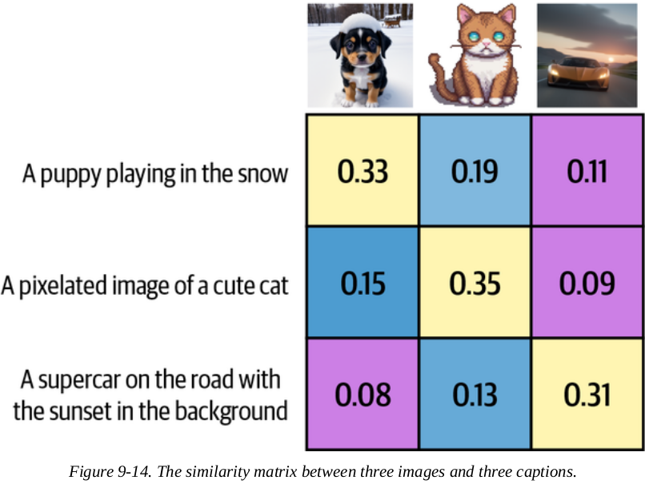
OpenCLIP
To know how this compares against other scores, and to know whether this should be considered good, we need to see how others score:
As you can see, a score of 0.33 is actually high in comparison to similarities with other images.

Slide 33
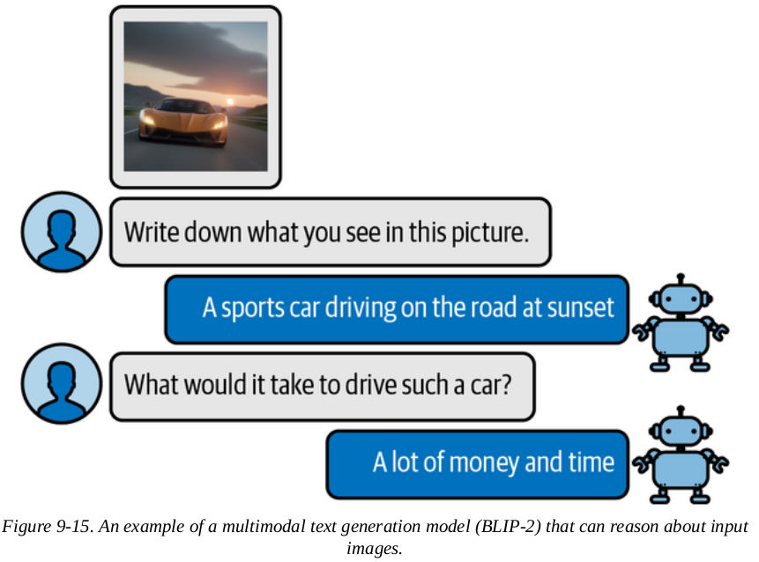
Making Text Generation Models Multimodal
To bridge the gap between vision and language, researchers have worked on adding multimodality to existing models.
One method is called BLIP-2 (BLIP-2 stands for Bootstrapping Language-Image Pre-
training for Unified Vision-Language Understanding and Generation 2).

Slide 34
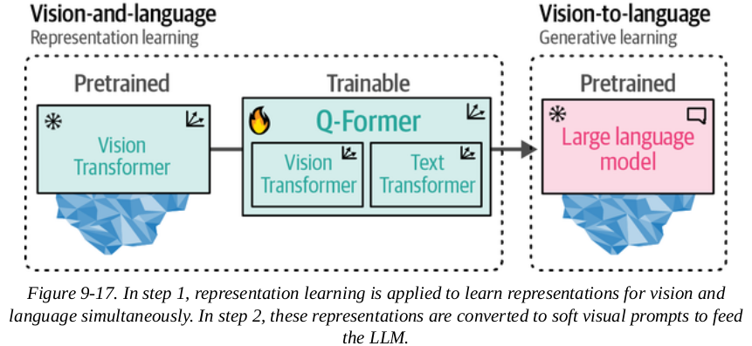
BLIP-2: Bridging the Modality Gap
The Q-Former is trained in two stages, one for each modality:
Step 1: Image-document pairs are used to train the Q-Former. These pairs teach it to represent both images and text. The pairs are usually captions of images, like we saw with CLIP.

Slide 35
BLIP-2: Bridging the Modality Gap
To connect the two pretrained models, the Q-Former copies their architectures. It has two modules that share attention layers:
Image Transformer: Interacts with the frozen Vision Transformer to extract features
Text Transformer: Interacts with the LLM

Slide 36
BLIP-2: Bridging the Modality Gap
The images are input into ViT to generate image embeddings, and the text is input into a text embedding model.
With these inputs, the Q-Former is trained on three tasks:
Image-text contrastive learning: Aligns pairs of image and text embeddings to maximize their mutual information.
Image-text matching: A classification task that predicts whether an image and text pair match.
Image-grounded text generation: Trains the model to generate text based on the input image.

Slide 37
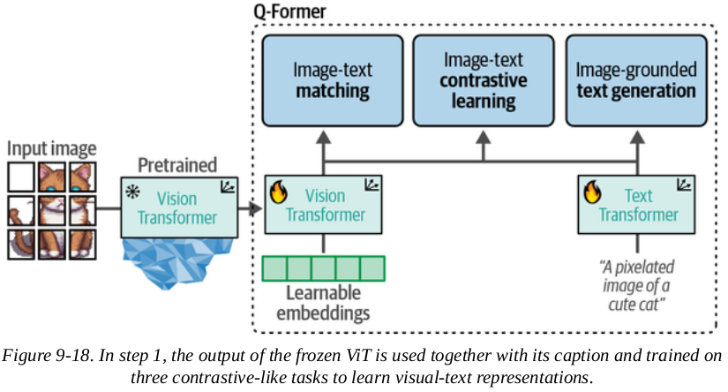
BLIP-2: Bridging the Modality Gap
These three objectives are optimized together. This first step of BLIP-2 is shown below:

Slide 38
BLIP-2: Bridging the Modality Gap
The Q-Former is trained in two stages, one for each modality:
Step 2: takes the learnable embeddings from step 1, which now contain visual information in the same dimensional space as text, and passes them to the LLM as soft visual prompts.
These embeddings condition the LLM on the visual representations extracted by the Q-Former.
A fully connected linear layer sits between them to ensure the embeddings have the right shape for the LLM. This second step converts vision to language.

Slide 39
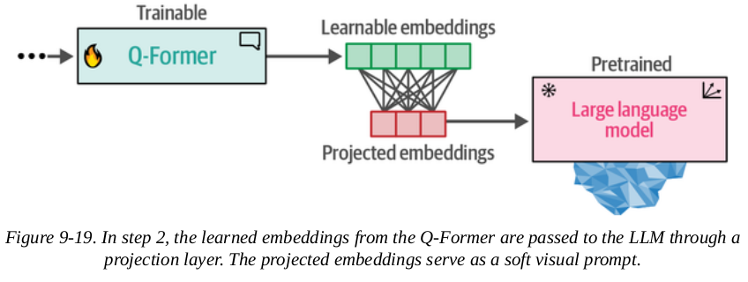
BLIP-2: Bridging the Modality Gap
The Q-Former is trained in two stages, one for each modality:
Step 2

Slide 40
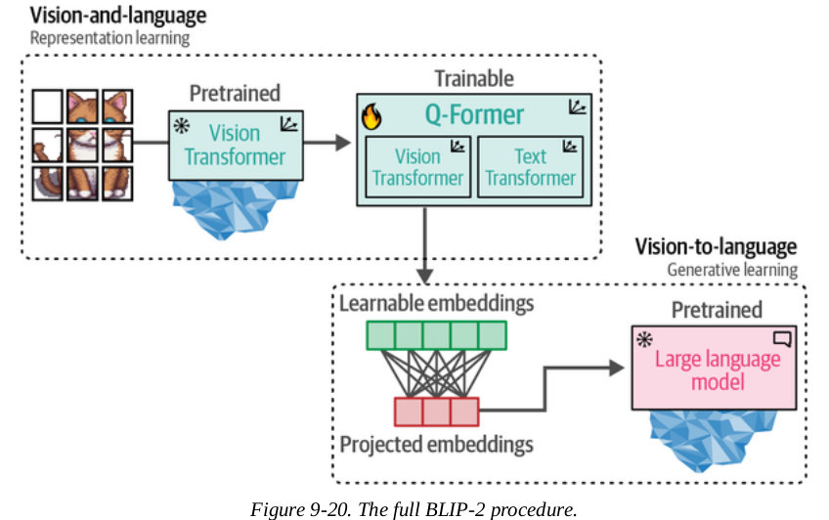
BLIP-2: Bridging the Modality Gap
When combined, these two training steps enable the Q-Former to learn visual and textual representations in the same space.
The full process is shown.

Slide 41
Preprocessing Multimodal Inputs
Now that we know how BLIP-2 is created, let's look at some use cases:
Captioning images
Answering visual questions
Prompting

Slide 42
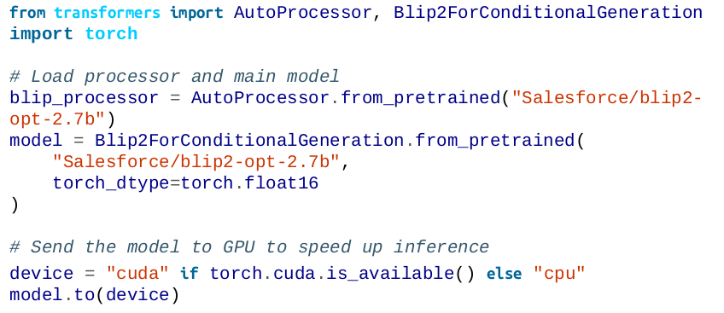
Preprocessing Multimodal Inputs
Before we look at use cases, let's load the model and see how to use it:

Slide 43
Preprocessing Multimodal Inputs
We loaded two components that make up our full pipeline:
Processor: Like the tokenizer for language models, it converts unstructured input (images and text) to representations the model expects
Model: The main BLIP-2 model

Slide 44
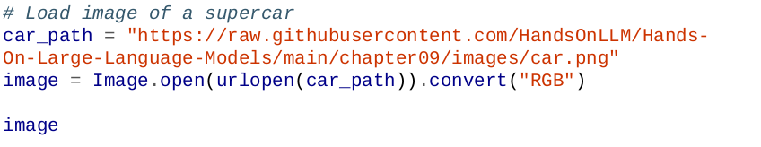
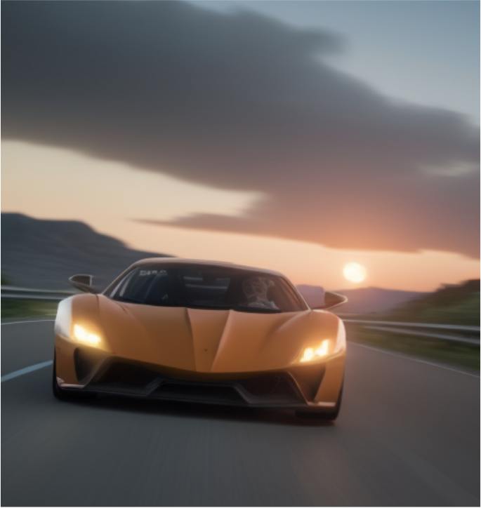
Preprocessing images
We'll start by loading a very wide image for illustration:
The image has 520 × 492 pixels, which is generally an unusual format.

Slide 45
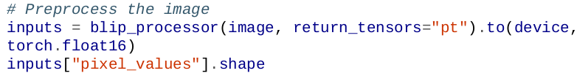
Preprocessing images
So let's see what our processor does to it:
This gives us the following shape:
The result is a 224 × 224 image.
This means all images are processed into squares.

Slide 46
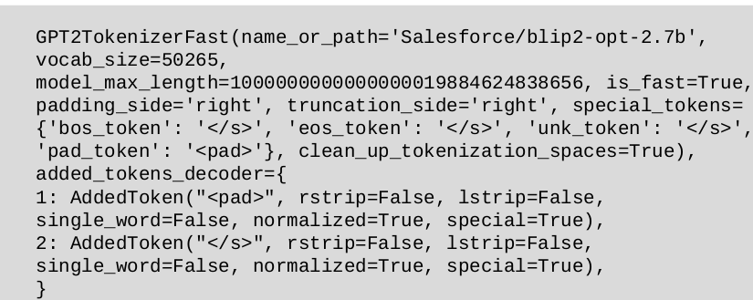
Preprocessing text
First, we can access the tokenizer it uses:
This gives us the following output:

Slide 47
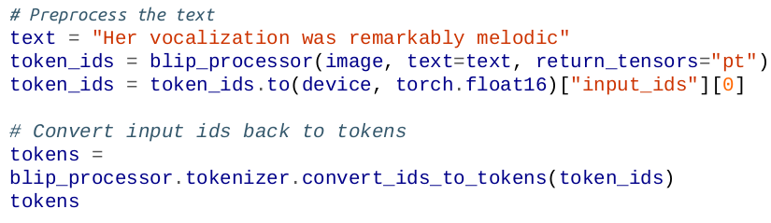
Preprocessing text
This BLIP-2 model uses a GPT2Tokenizer. Let's see how GPT2Tokenizer works:
This gives us the following tokens:

Slide 48
Preprocessing text
You might notice a strange symbol: Ġ . The space (code point 32) becomes Ġ (code point 288). We'll convert them to underscores for clarity:
This gives us a nicer output:

Slide 49
Use Case 1: Image Captioning
The simplest use of BLIP-2 is to create captions for images.
The captioning process follows these steps:
An image is converted to pixel values the model can read
These pixels are passed to BLIP-2
They're converted into soft visual prompts
The LLM uses these prompts to decide on a caption

Slide 50
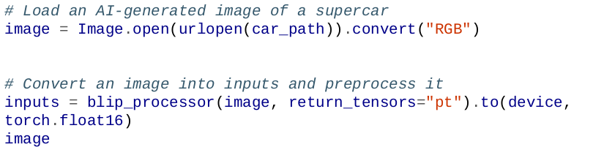
Use Case 1: Image Captioning
Let's take the image of a supercar and use the processor to derive pixels in the expected shape:

Slide 51
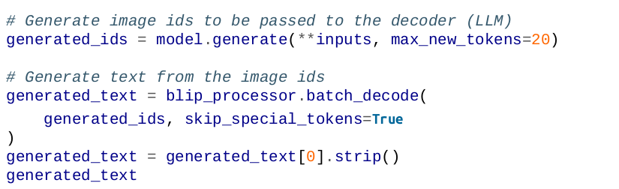
Use Case 1: Image Captioning
The next step is converting the image into token IDs using BLIP-2. We then convert the IDs into text. This gives us the generated caption:
generated_text contains the caption:

Slide 52
Use Case 2: Multimodal Chat-Based Prompting
Let's take the image of a supercar and use the processor to derive pixels in the expected shape:
Visual Question Answering:
We give the model an image and a question about that image
The model needs to process both the image and the question together
Let's demonstrate with a picture of a car:

Slide 53
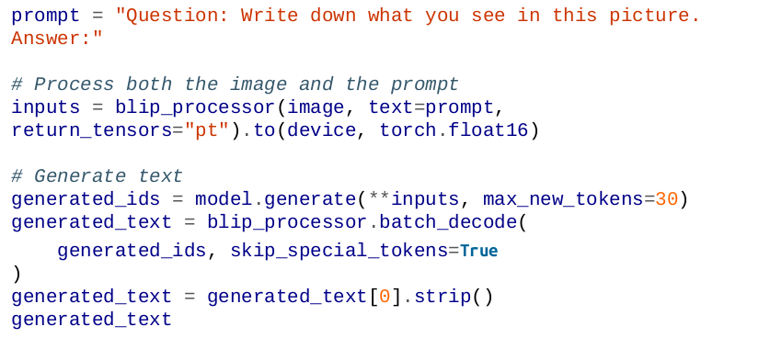
Use Case 2: Multimodal Chat-Based Prompting
For visual question answering, we need to give BLIP-2:
The image
A prompt (without it, the model would just generate a caption)

Slide 54
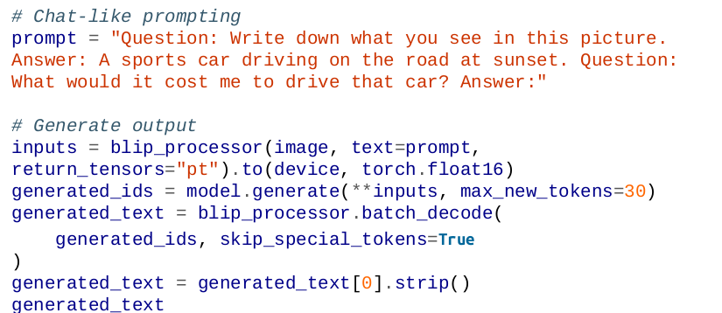
Use Case 2: Multimodal Chat-Based Prompting
This outputs:
Then we ask a follow-up question:

Slide 55
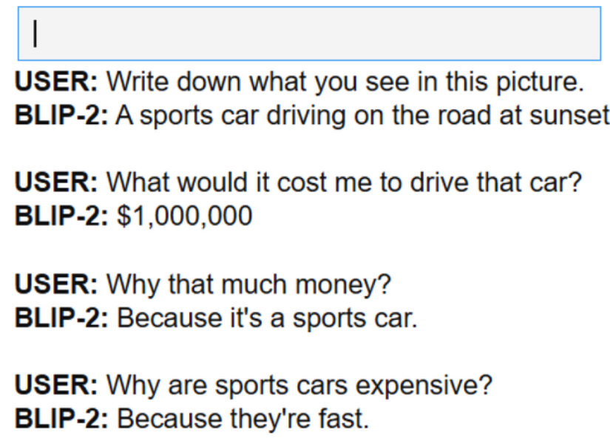
Use Case 2: Multimodal Chat-Based Prompting
We can make this process smoother by creating an interactive chatbot by using ipywidgets , an extension for Jupyter notebooks to let us create interactive buttons, input text. The full code is on the book/notes.
This will result to:

Slide 56
END

